Slide 1

From Tamales to TSIA
LEVERAGING ACE & THE EFFECTIVE ADVISING FRAMEWORK
TO DRIVE STUDENT SUCCESS
Mona Guerra
Jacob Martinez
Mercedes ISD

Slide 2
CONTENTS
Framework Overview: Introduction to the EAF and its role in Mercedes ISD.
Strategic Lever 1: Leadership & Planning: Details on your EAF Steering Committee and steering committee members.
Strategic Lever 3: Internal Culture of Advising: Community engagement, family nights ("Tamales"), and staff roles.
Academic Readiness & TSIA: Leveraging ACE funding, IXL bell-ringers, and faculty collaboration.
Tools for Sustainability: Integration of SchoolLinks for career exploration and tracking.
Next Steps & Implementation: Future goals for FAFSA/TASFA and long-term EAF milestones.

Slide 3

FRAMEWORK OVERVIEW
Through Region One and the Effective Advising Framework (EAF), Mercedes ISD has been working to create a blueprint for planning, implementing, and evaluating an individual planning system within the comprehensive school counseling program.
Our goals involve raising awareness regarding post secondary readiness by strengthening and expanding or current community-based partners, equipping all of our staff with the knowledge to guide students through college/university enrollment, and revamping our TSIA practices.

Slide 4
FRAMEWORK OVERVIEW
The Effective Advising Framework is designed to provide technical assistance that fostered different perspectives of how to achieve goals that as a district, we were already working toward. Our coaches, Amanda Cardoza and now Karla Deluna, have been excellent in guiding us through every step of the process from the planning phase to now. I think sometimes, especially in the planning phase, having that outside perspective, even sometimes as simply as having an outside presence and designated time for our team to plan, provided us the opportunity to answer our own questions and solutions to our own problems. Currently, Mercedes ISD is in the second year of the cycle, where initiatives that we began planning over a year ago are starting to come into fruition.

Slide 5
AREAS WE WANT TO GROW AS A DISTRICT
  Over time, our postsecondary readiness data shows strong gains in CCMR performance, especially in dual credit completion, industry certifications, and associate degrees, along with steady growth in CTE Completers and Outcome Bonuses. However, we continue to see a need for focused improvement in meeting TSI benchmarks and increasing AP/IB performance. A key strength is that our direct-to-college enrollment rate is above the state average, and emergent bilingual students exceed both district and state averages in earning Industry-Based Certifications.
  FAFSA completion is another relative strength, falling just slightly below the state average. Areas for improvement include increasing TSI, AP/IB, and dual credit completion rates for special education and emergent bilingual students, as these indicators remain well below district and state performance and represent important opportunities to strengthen overall CCMR readiness.

Slide 6
AREAS WE WANT TO GROW
Different student groups are experiencing CCMR outcomes unevenly. While some groups perform well, such as emergent bilingual students earning Industry-Based Certifications, other indicators, including TSI, AP/IB, and dual credit completion for special education students and emergent bilingual students, remain significantly below district and state averages.
      Strengthening individualized advising and postsecondary planning
        Action steps include increasing student access to one-on-one advising sessions, embedding regular career exploration and planning checkpoints, and improving communication about pathway options and readiness expectations
        Enhancing TSI intervention systems, including early diagnostics, targeted skill-building, and consistent progress monitoring.
        Deepen family and community partnerships, providing clearer resources and support for FAFSA completion, postsecondary applications, and career decision-making to ensure families can fully participate in students’ planning processes.

Slide 7
KEY POINTS
Raising district-wide percentage of students who are TSIA complete
Raising district-wide percentage of students completing their FAFSA or TASFA applications
Ensuring equitable opportunities in access to Industry Based Certifications. Directing focus to our Economically Disadvantaged (Eco Dis) Students, Emergent Bilingual / English Learners (EB/EL), and students Receiving Special Education Services in order to ensure that they are being given meaningful opportunities to build real-world skills that translate directly into workforce readiness
All intention directly ties into the Texas Model for Comprehensive School Counseling Programs including but not limited to: “career development theory, developmental responses to the whole child and appropriate exploration, coordinated advisement procedures to facilitate appropriate placement decisions by students and their parents” (Texas Education Agency, 2024)

Slide 8
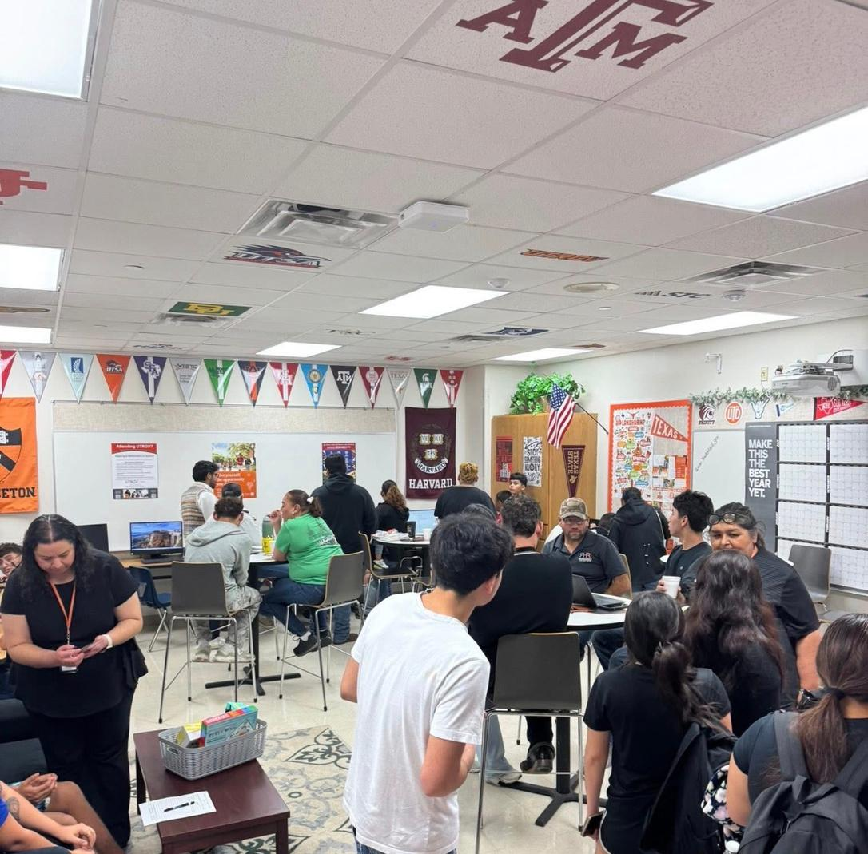
COLLABORATION
Through after-school ACE tutoring focused on TSI preparation, students increase TSI college readiness, a key goal of the EAF Grant. In collaboration, both programs also support FAFSA completion, aligning academic acceleration with postsecondary access.

Slide 9
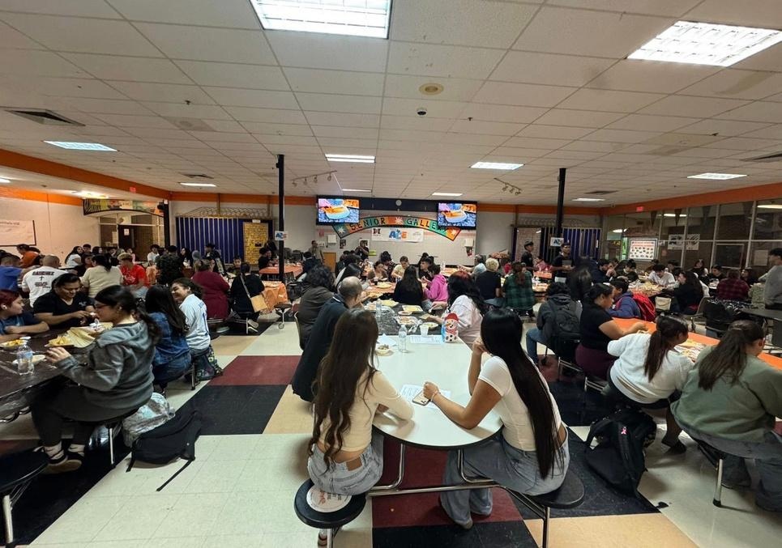
PARENT ENGAGEMENT
The partnership extends into the community through culturally relevant, family-centered events, such as a tamalada paired with a FAFSA night, allowing the district to collaboratively meet multiple grant goals while ensuring students are truly college, career, and military ready.

Slide 10
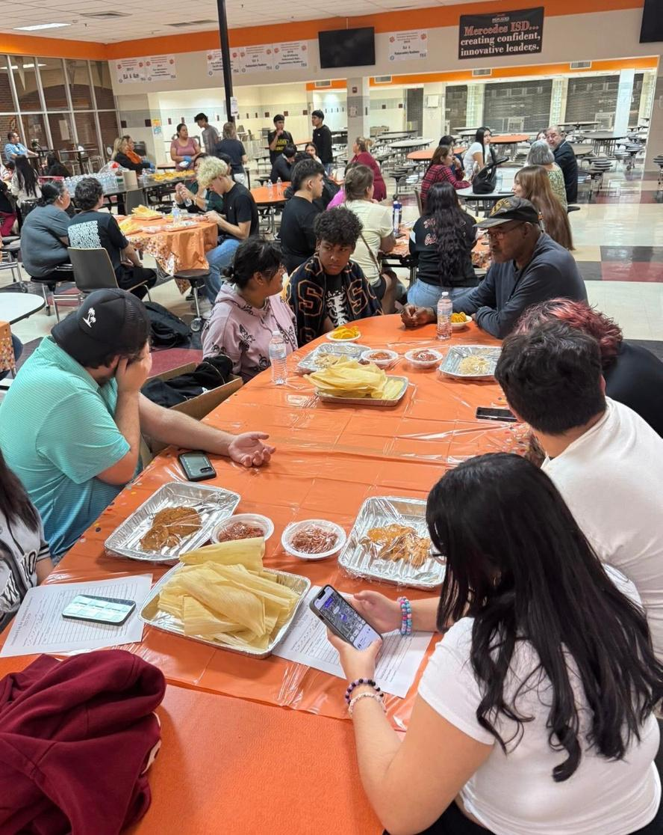

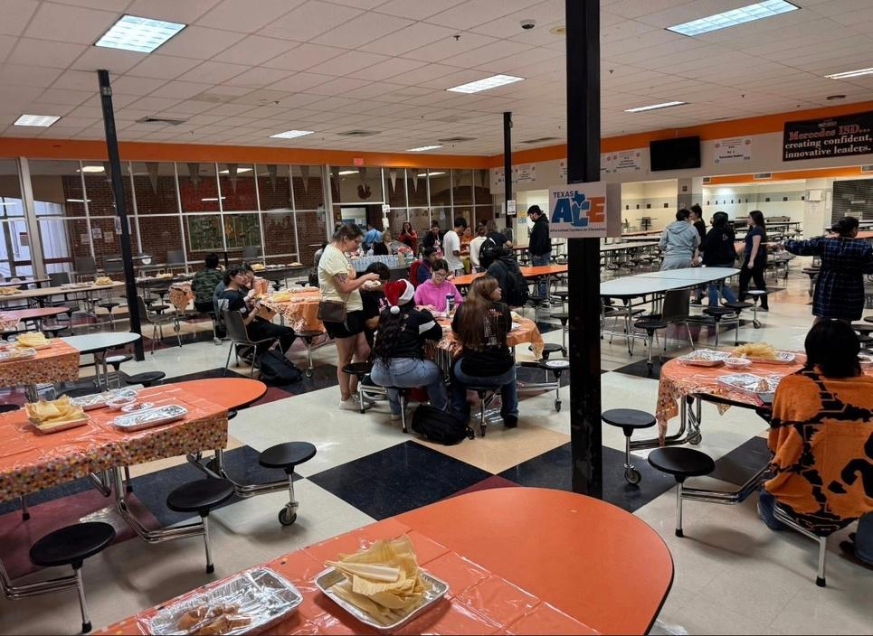
COMMUNITY ENGAGEMENT

Slide 11
MERCEDES ISD TSIA TUTORIALS
We facilitated after-school TSIA tutorials by leveraging ACE funding to compensate our English and Math faculty.
Additionally, our CTE teachers got in on the fun by assigning TSIA bell-ringers from IXL before class periods. Some of our CTE teachers even made this a competition between each other.
Intentional blitz sessions are our next effort in TSIA intervention at Mercedes High School

Slide 12
SUPPORT BY WAY OF MATERIALS
One way that we are soon going to be able to improve our tracking practices, scheduling, and streamline career exploration is through our aquisition on School Links, this was made possible through the Effective Advising Frameworks grant, who strive to “support the use of high-quality materials and assessments as well as the provision of adequate training and support for implementation” (Texas Education Agency, 2024).
School Links should assist greatly in our aboility to sustain these efforts, ensuring that Mercedes ISD students are not only graduating but are truly equipped for their chosen postsecondary pathways

Slide 13
KEY FACTORS
Academic Acceleration: Leveraging ACE tutoring specifically for TSI, however this should trickle into other testing should our students be able to master the TSIA
Financial Access: Jointly facilitating FAFSA/TASFA completion to exceed baseline set in the 24-25 school year and ensuring financial barriers do not impede college enrollment
Community Integration: Utilizing culturally relevant family nights to build trust and increase engagement and in doing so, positively affect the district’s Internal Culture of Advising

Slide 14
Thank you!

Slide 15
REFERENCES
Morath, M., Commissioner of Education, Schwinn, P., Deputy Commissioner, Academics, Martinez, M., Associate Commissioner, Standards and Support Services, Ramos, S., Director, Curriculum Standards and Student Support, Snyder, J., Director, Special Projects, Texas Education Agency, Zambrano, E., Ph. D. ,. Task Force Chair, Cox, E., M. S. ,. Assistant Professor, Kessel, S., M. Ed. ,. Director of Student Services and Safety, Lerma, E., Ph. D. ,. Assistant Professor, Solmonson, L., Ph. D. ,. Professor, & Wines, L. A., Ph. D. ,. Assistant Professor, Administrator to Program Oversight and Accreditation. (2018a). The Texas model for comprehensive school counseling programs (Fifth Edition) [Book]. Texas Counseling Association. https://tea.texas.gov/academics/learning-support-and-programs/school-guidance-and-counseling/pub2018texas-model5th-edition.pdf
Texas Education Agency. (2024). Effective Advising Framework (EAF) and Effective School Framework (ESF) crosswalk. In Texas Education Agency. https://eaf.tea.texas.gov/sites/eaf.tea.texas.gov/files/2024-08/eaf-and-esf-crosswalk.pdf

